Slide 1
Additional Members meeting November 2022
Welcome
November 25, 2022

Slide 2
Agenda
Welcome by President Elisa Finco
Directors’ Report March – November 2022 Developments, current affairs and further steps
IPPE – update and plan further steps
Coffee break
4. Budget 2023
ShowCo Calendar Update 2023 – 2025 International/Regional en National/local shows
Other business
November 25, 2022

Slide 3
Directors’ Report March – November 2022

Slide 4
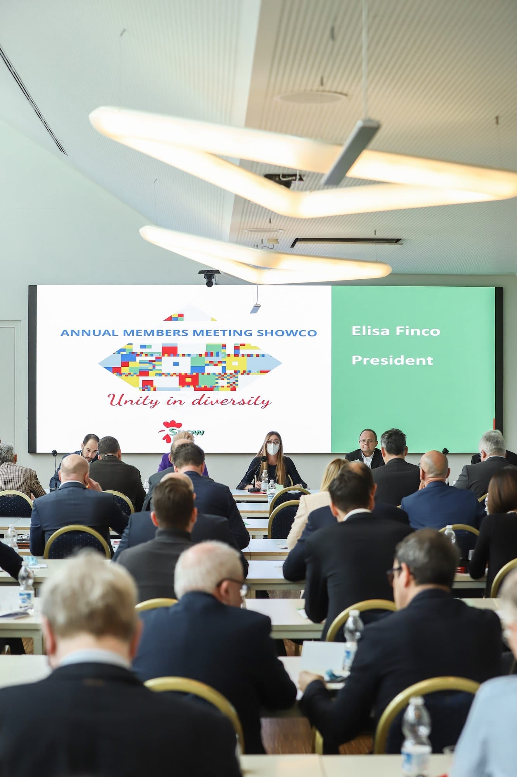
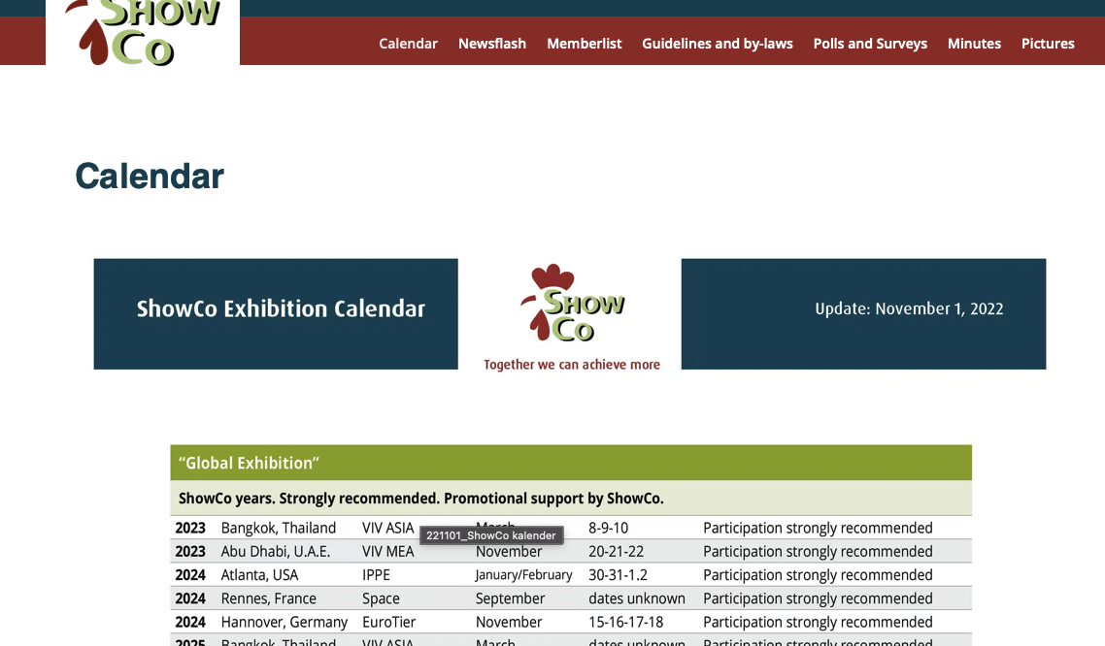
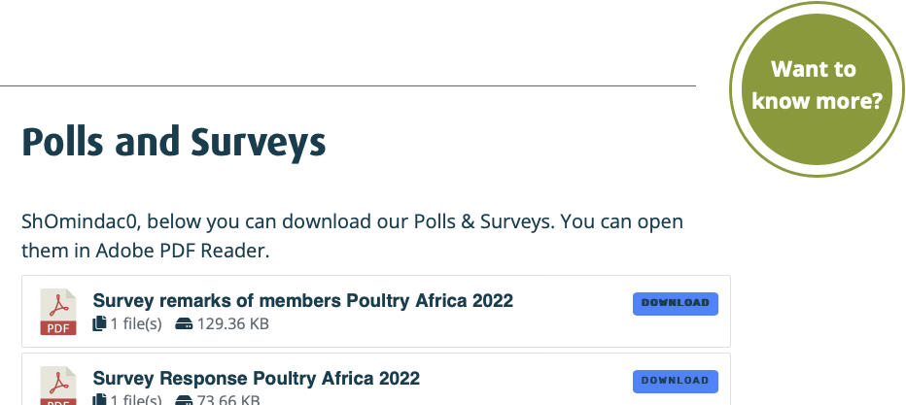
Internal
Regular News Flashes
WhatsApp groups (Board and members) No member yet? Please register
Members meetings (3rd day of global fair; annual meeting, additional meeting)
Build up databases (work in progress)
Surveys of fairs-
Updated members area www.showco.org
November 25, 2022

Slide 5
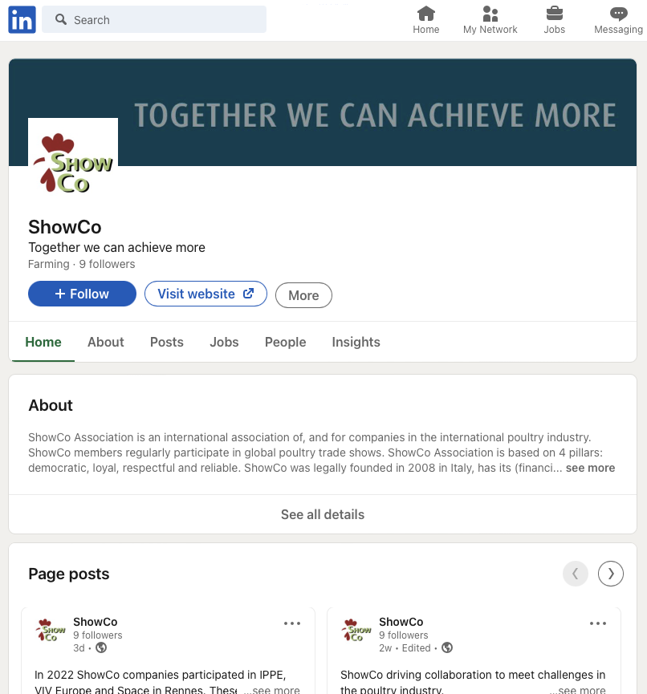
External
Revised website
LinkedIn page
Booth at global fairs
Communication plan (advertising, press releases) - work in progress
External stakeholder management – work in progress
New VIV contract use VIV invitation link
Agreement with DLG/EuroTier – work in progress

Slide 6
Others
Invoice issue EuroTier 2020 – solved
IPPE issue – work in progress >> Members meeting November 2022
Increase external stakeholder management (processors, feed/milling, genetics, ingredients, poultry organizations etc.)
Optimize external communications (i.e. online vs. print, new tools, p.r. etc.)
Added value membership ShowCo Association
Further steps

Slide 7
IPPE – current situation
Over 10 years on-going discussions in member meetings.
Results: -differences in opinion per company/product portfolio -some members decided to comply to the recommendations, others not -some members had permission to not comply -misunderstandings, unhappy members -possible loss of credibility etc. etc.
Question: can we solve this
Can we ‘Walk the talk’ and ‘Talk the walk’
November 25, 2022

Slide 8
IPPE – update
Focus on members in Housing Equipment (the main part of ShowCo members)
Contacts and talks (phone, email, personal)
Complying to recommendations IPPE 2023 Texha and Agritech
Fienhage, Gartech, Gasolec and OvoVision have requested to end their membership by 1.1.2023
Kutlusan will participate in IPPE 2023 > as from 2024 compliant to recommendations
Munters will participate in IPPE 2023
We lost members in the housing equipment group, but………… -issue in Housing equipment group seems to be solved
November25, 2022

Slide 9
IPPE – update
Next steps
We are going to form 3 (small) member groups (breeders/eggs/hatchery)
Discussions in/with/by members in -Breeding (HyLine/Lohmann Breeders) -Eggs (Moba, Sanovo, Sime-Tek, Kuhl, Innovatec) -Hatchery (JCMI, Royal Pas Reform, Petersime)
We will ask the members in these groups if and how we can solve the issue in the group
Report/results in Annual meeting 2023
November25, 2022

Slide 10
Coffee break
November 25, 2022

Slide 11
ShowCo calendar
Since March 2022 publication of calendar for members only - we receive questions from companies (please send calendar) - we receive questions of fair organisers (include in calendar)
Our ShowCo calendar is an important and recognized tool. To discuss thoroughly at annual meeting 2023.
November 25, 2022

Slide 12
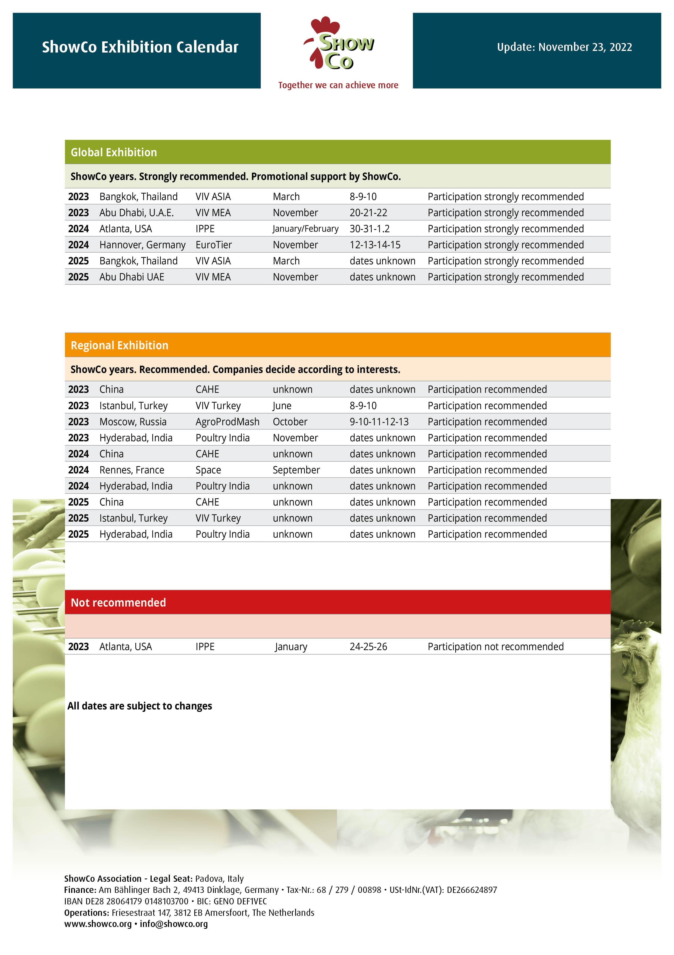
Current ShowCo calendar
November 25, 2022

Slide 13
ShowCo calendar
Do you have questions about up coming VIV ASIA / VIV MEA ?
19 members participated in Poultry Africa Overall ranking 7.2. Proposal: Regional Sub Saharan show in calendar as from 2024
Investigation (5) ShowCo participants Poultry India
Other shows – please send suggestions/opinions (to be discussed at Annual members meeting, June 2023)
November 25, 2022

Slide 14
Current ShowCo Recommendations guidelines
For your information / to refresh your memory
In Exhibition Plan (Calendar). Leading Global Poultry Shows across a continent. Strongly recommended and promotional support. Biannual participation.
International Regional Poultry exhibitions - International shows in a country also focussing on group of neighbouring countries in region. - No further ShowCo support. - Yearly and/or biannual participation
National/local trade fairs - No ShowCo area of activities
November 25, 2022

Slide 15
Current ShowCo Recommendations Guidelines
ShowCo members with poultry plus product portfolio: Yearly participation in trade fairs possible if No participation in Poultry section No showing/distribution Poultry products, messages, materials Restrictions for dealers: no financial/personnel support; no brands, no logo’s, brochures). In no ShowCo years i.e.
Do we need to clear up the guidelines?
Proposal: Discussion on calendar and guidelines in Annual Meeting 2023.
November 25, 2022

Slide 16
Other business
Save the date:
Annual Members meeting 2023
June 15, 16
Hosted by VDL in Eindhoven, NL
Other business?
November 25, 2022

Slide 17
Other business
??????
November 25, 2022

Slide 18
For further questions, remarks or ideas, please contact Fenny
Please leave your badge in this room before departure
Thank you for your attendance and valuable input
Have a good trip home and a nice weekend
November 25, 2022

